Slide 1
MiniProject 3
110033203巫奕賢

Slide 2
MiniMax
Now
:Player
:Opponent
A
B
3
3
6
3
max
C
D
E
2
2
6
min
7
3
F
1
G
1
H
1
I
1
1
J
K
5
max
6
7
4
5
3
max
0
0
0
0
0

Slide 3
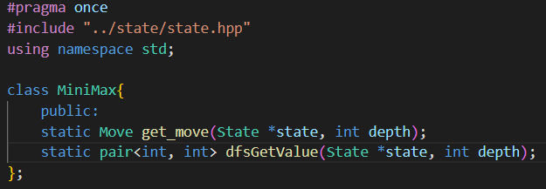
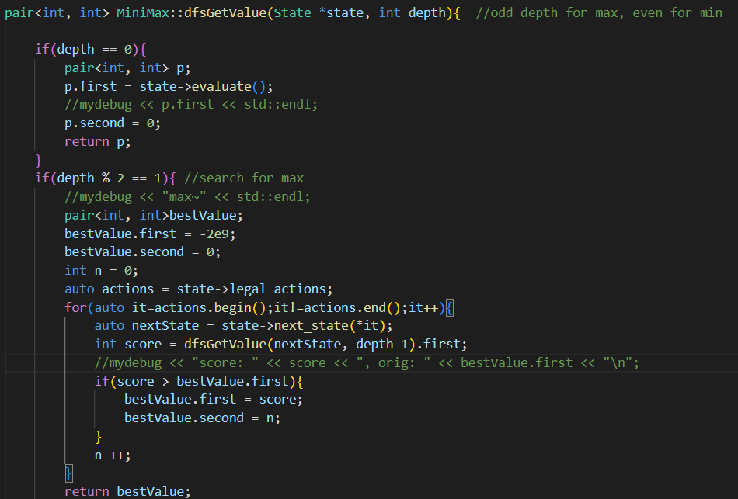
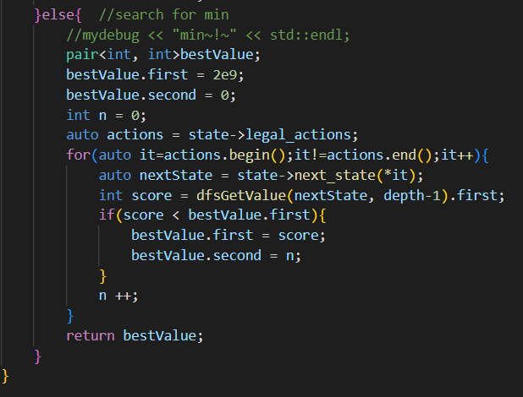
Recursion

Slide 4
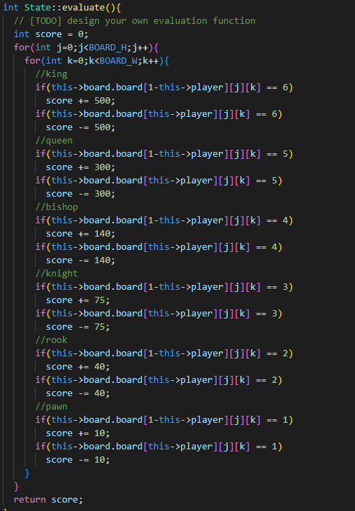
Evaluate function

Slide 5
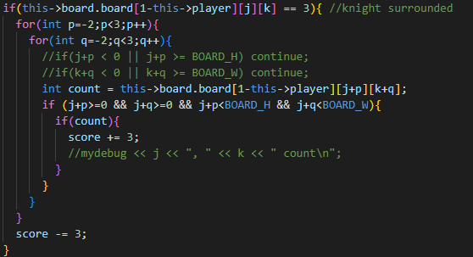
Enhancement

Slide 6
Alpha-Beta
Now
α: -INF
β: INF
:Player
:Opponent
A
B
3
3
6
α: -INF
β: 6
max
C
D
E
2
2
6
α: 6
β: INF
7
α: 7
β: 6
min
F
1
G
1
H
1
I
1
1
J
K
5
max
6
7
max
0
0
0
0
0

Slide 7
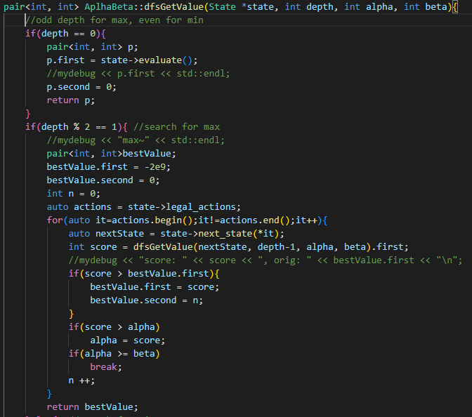
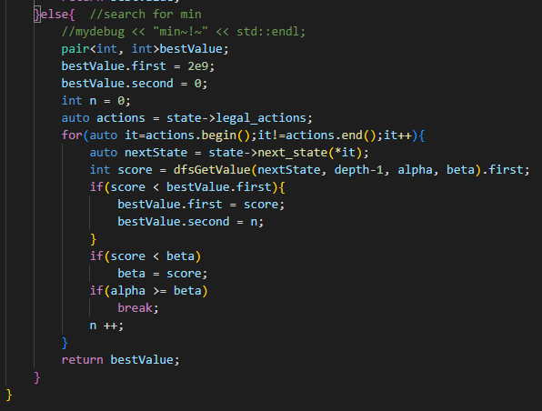
Recursion + alpha & beta

